Slide 1





OBJECT-ORIENTED PROGRAMMING
CPI A2 Computing 2020-2021
1
Notes:
Lisa

Slide 2
OBJECT-ORIENTED PROGRAMMING
UML Diagrams
Architecture
Interface
Conclusion
Notes:
Lisa

Slide 3

UML Diagram
Use Case Diagram
Activity Diagram
Sequence Diagram
Class Diagram
Notes:
Maxime

Slide 4
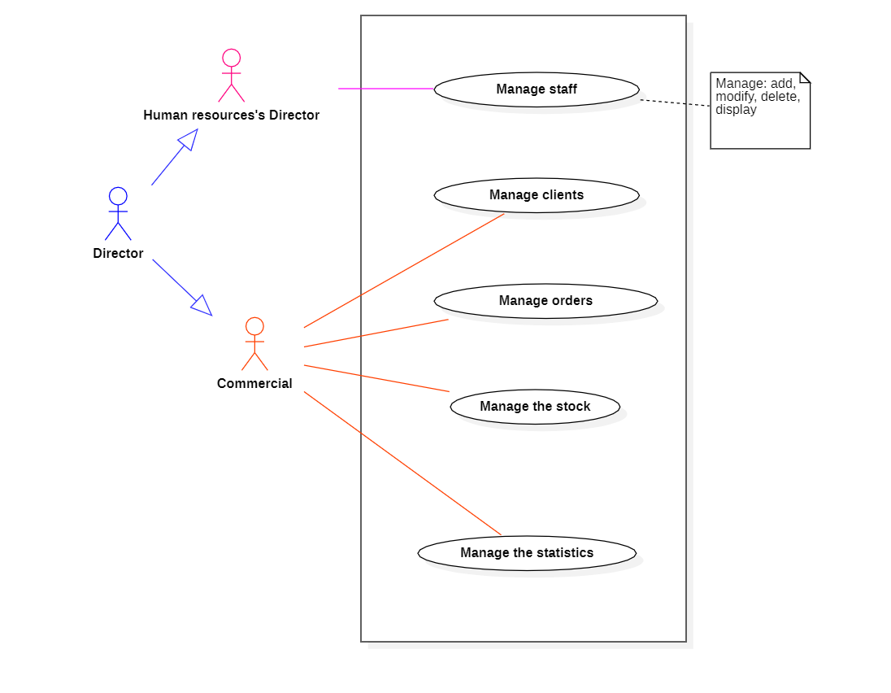
Use
Case
Diagram
Notes:
Maxime

Slide 5
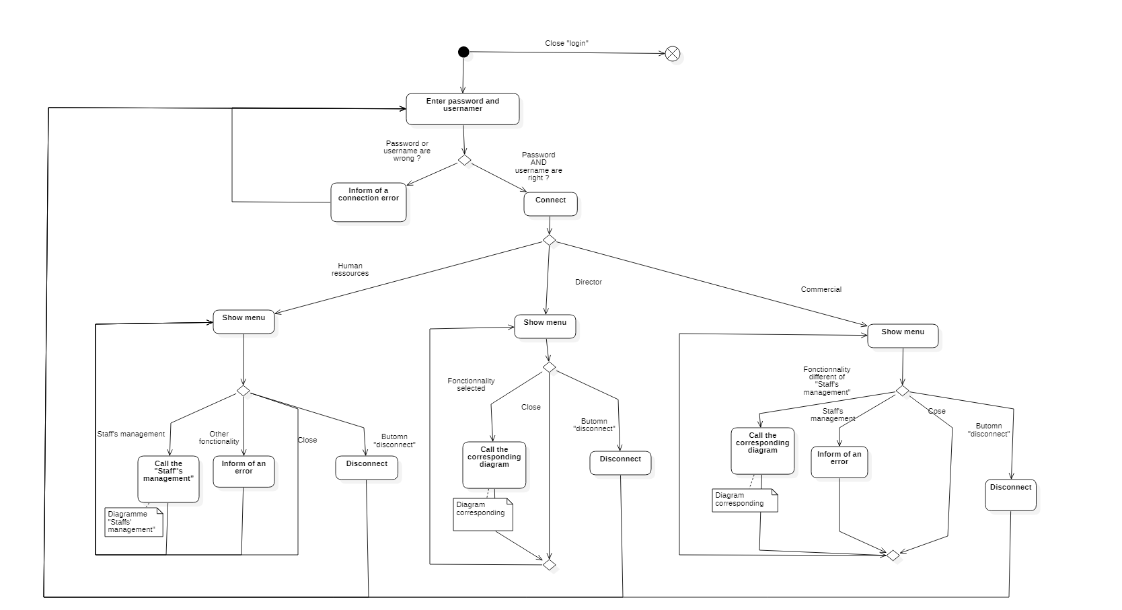
Activity Diagram
Notes:
Lisa

Slide 6
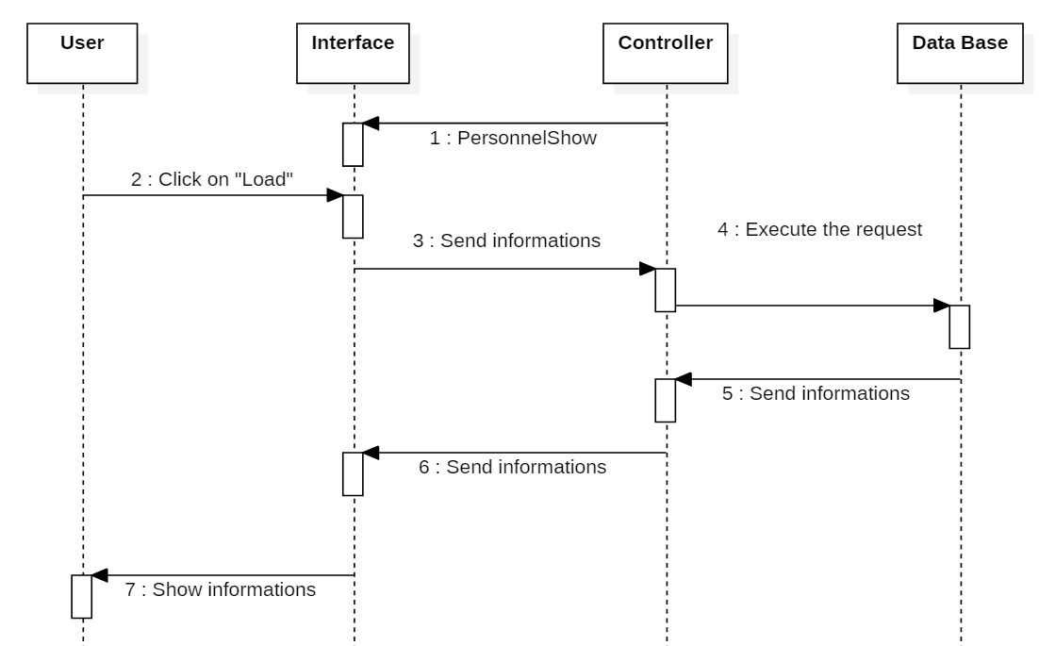
Show a staff
Sequence
Diagram

Slide 7
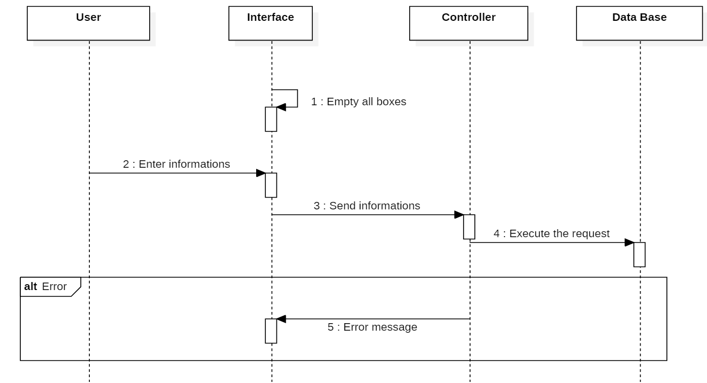
Add/Edit a staff
Sequence
Diagram

Slide 8
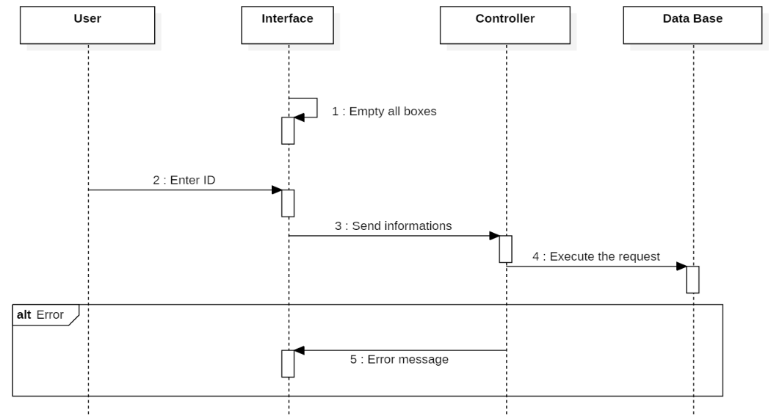
Delete a staff
Sequence
Diagram

Slide 9
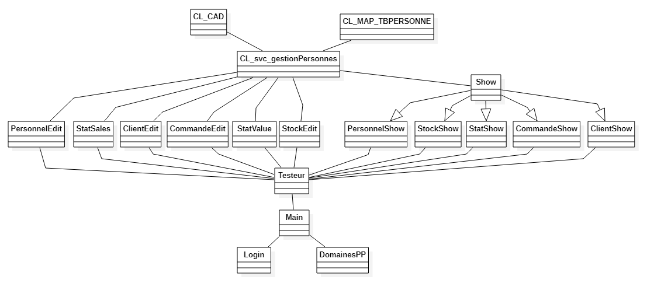
Class Diagram
Notes:
Maxime

Slide 10

Architecture
Data Base
Software

Slide 11
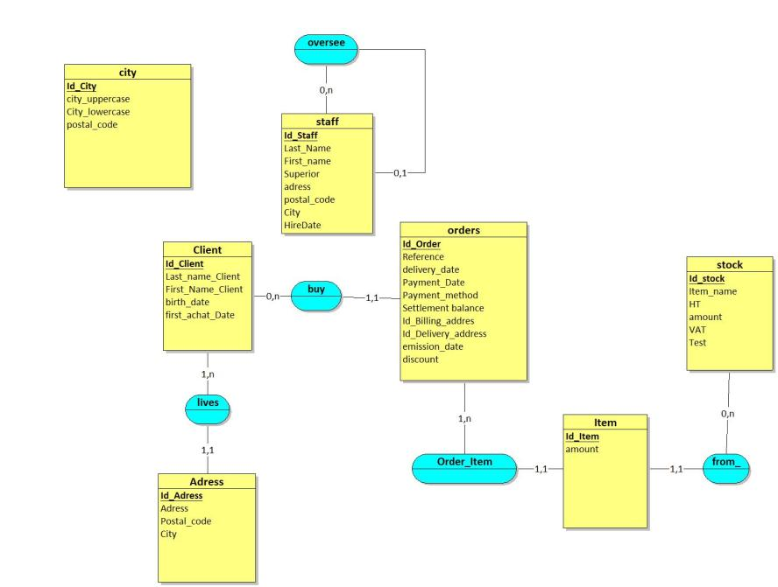
Data Base :
Entity Relationship Model
Notes:
Baptiste

Slide 12
Software :
Model – View - Controller
View
Asks the model’s
actual state
Controls after a user’s action
informs the view of
a state’s change
View’s update
Model
Controller
Notes:
Lisa

Slide 13

Interface
Login
Main Menu
Staff Management
Notes:
Hugues

Slide 14

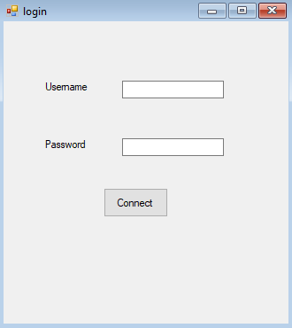


Login
Username
admin
Password
nimda
Username
RH
Password
HR
Username
commercial
Password
lairemmoc
Notes:
Hugues

Slide 15
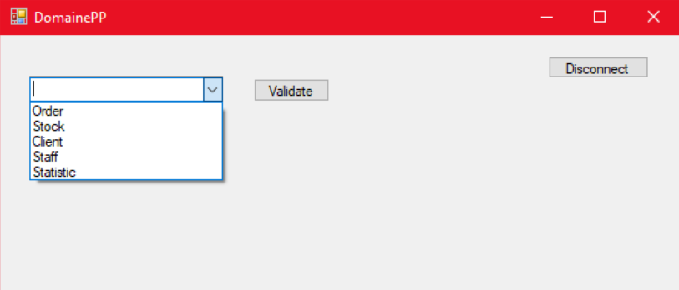
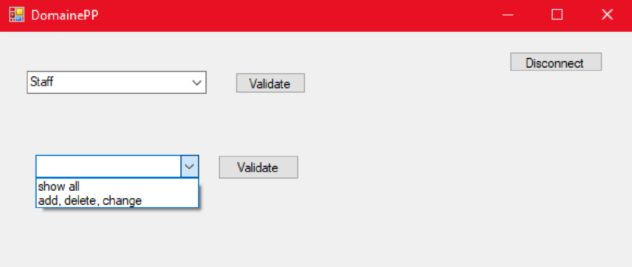
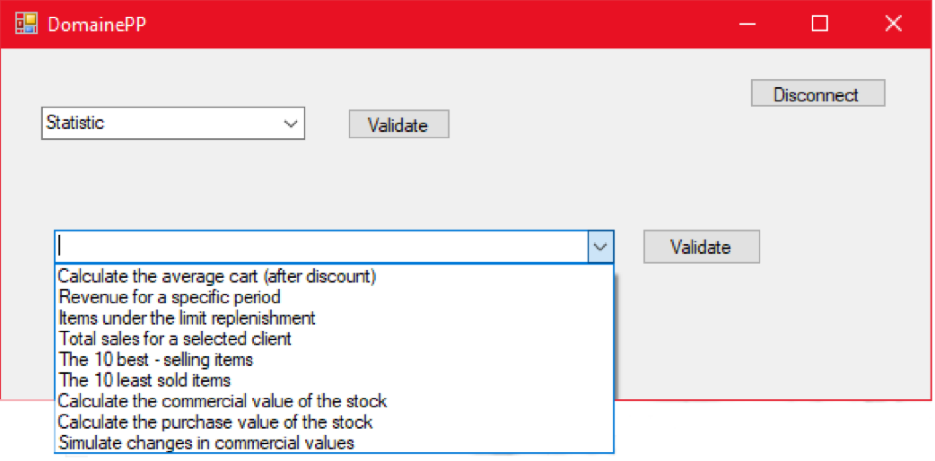
Main Menu
Notes:
Hugues

Slide 16
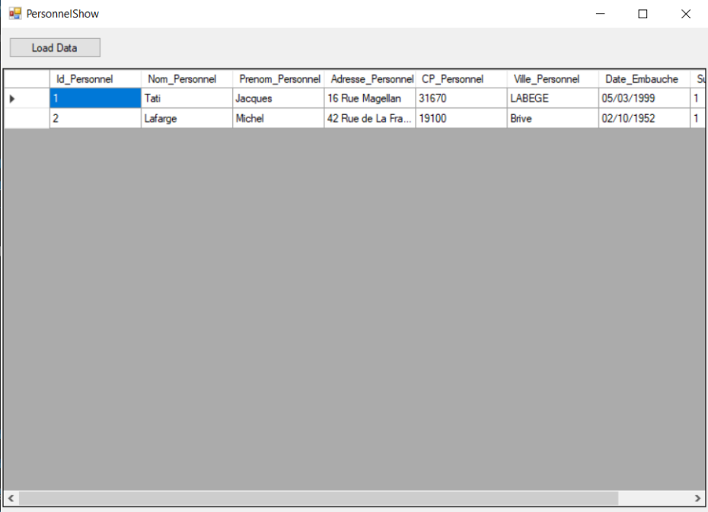
Staff Management
Notes:
Hugues

Slide 17
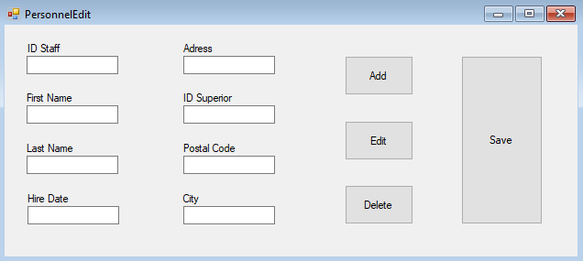
Staff Management
Notes:
Hugues

Slide 18
Thanks !
CROS Hugues, DEREMY Baptiste,
MOIROUD Maxime, PAPY Lisa
18
18
Notes:
Baptiste

